Slide 1
Sampling and Reconstruction Techniques for
Efficient Monte Carlo Rendering
PhD Dissertation Oral Presentation
Computer Science and Information Engineering
National Taiwan University
Yu-Ting Wu
吳昱霆
Advisor: Prof. Yung-Yu Chuang (莊永裕教授)
Presentation Date: May 30, 2014

Slide 2
Outline
Introduction
Background
Proposed Methods
VisibilityCluster: Average Directional Visibility for Many-Light Rendering
Dual-Matrix Sampling for Scalable Translucent Material Rendering
SURE-based Optimization for Adaptive Sampling and Reconstruction
Conclusion

Slide 3
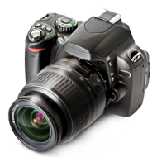

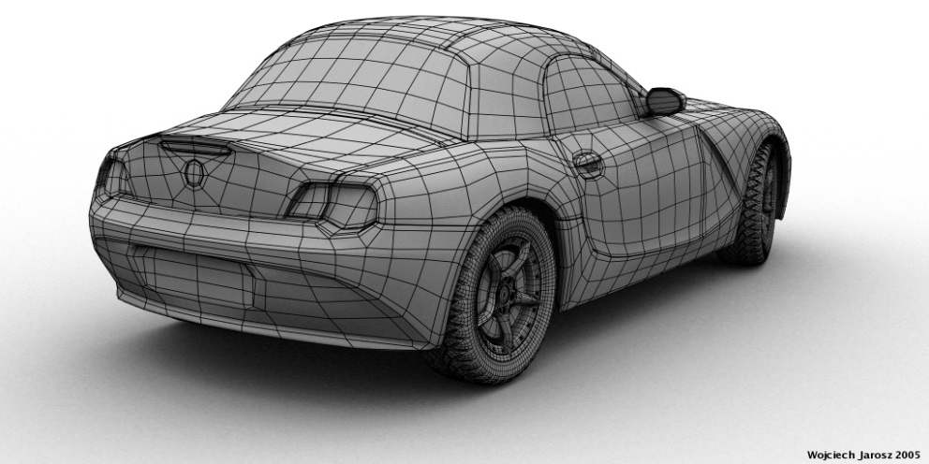
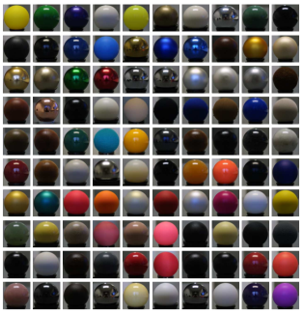
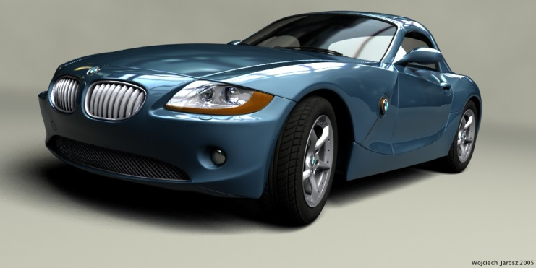
Rendering
Create a 2D picture of a 3D world
Camera
Lights
Geometry and Materials
Input: 3D description of a scene
Output: 2D synthetic image
Notes:
在這裡, rendering指的是從一個三維的場景描述synthesis出一張二維影像的過程
我們的input是場景中的geometry, material以及light sources的描述, rendering問的是從一組相機參數對此場景拍照會得到什麼樣的影像

Slide 4
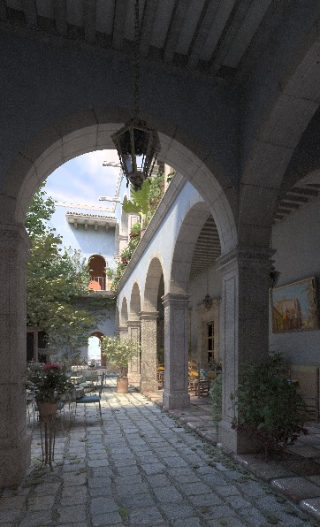
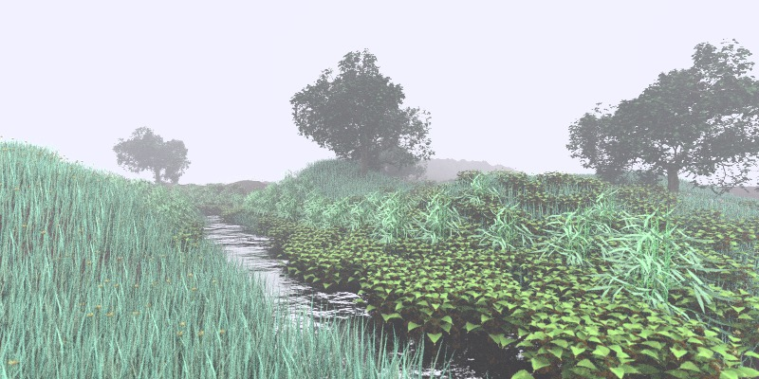
Physically-based Rendering
Simulate the interactions between surfaces and lights based on physics; realism is the primary goal
Notes:
在這篇論文中我們focus在physically-based rendering. 這類的方法根據物理學來模擬光與物體之間的交互作用

Slide 5
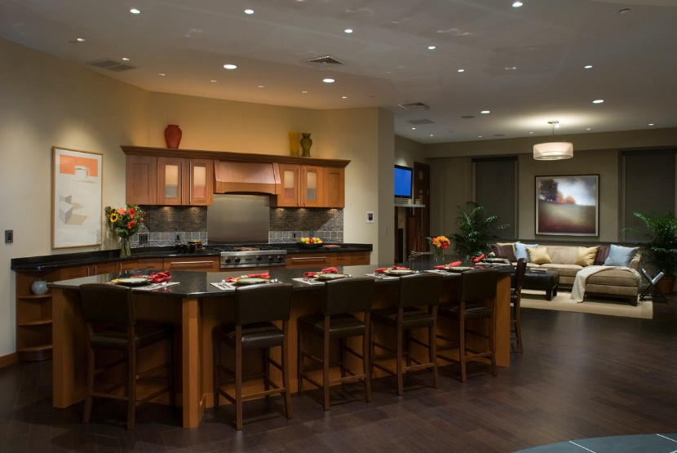
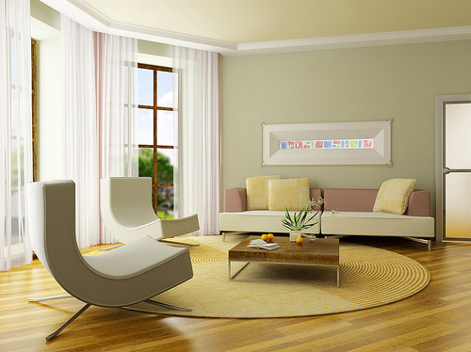
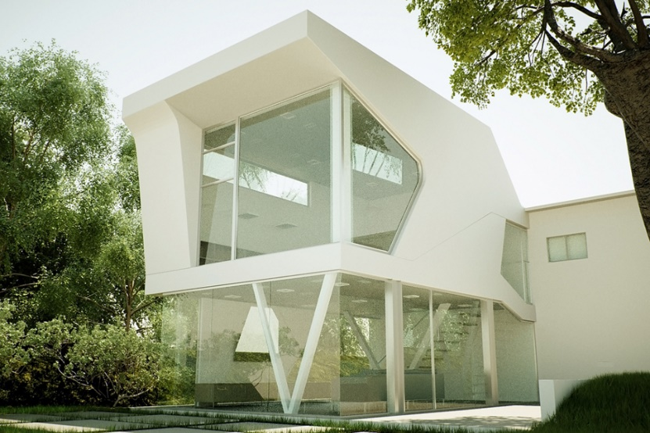
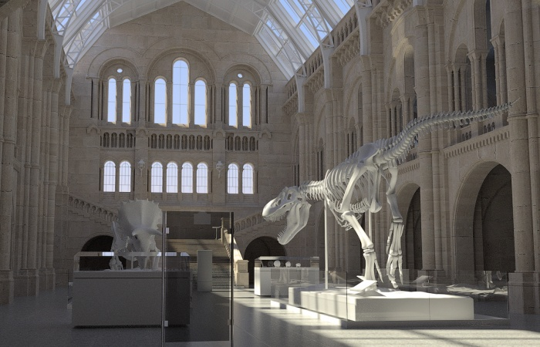
Applications of Physically-based Rendering
Lighting and architecture design

Slide 6
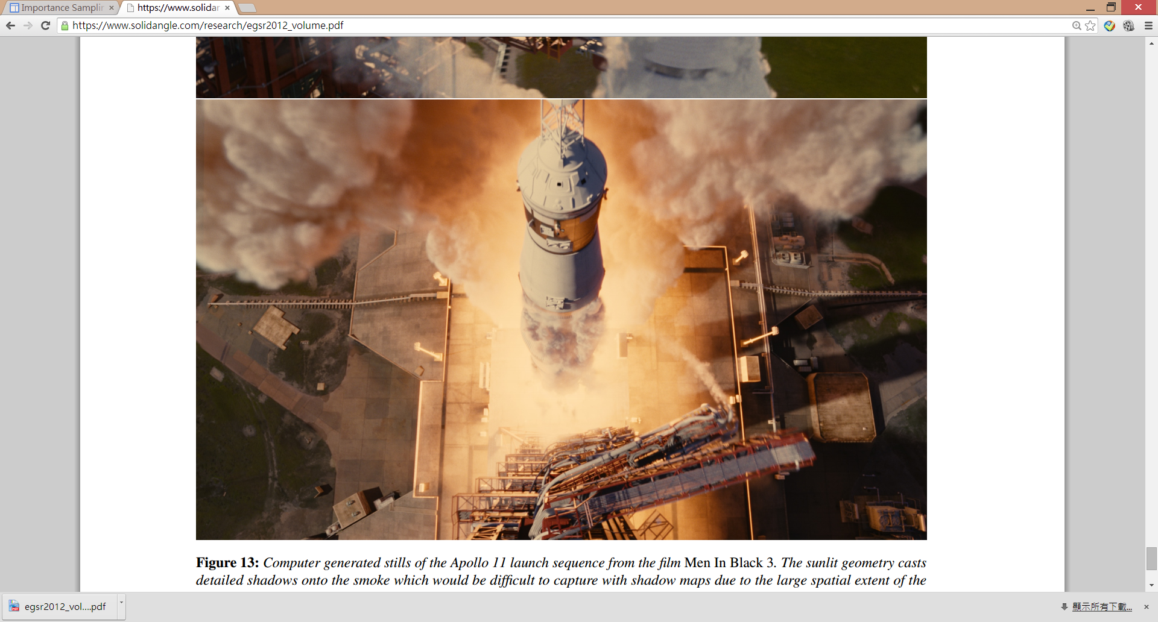
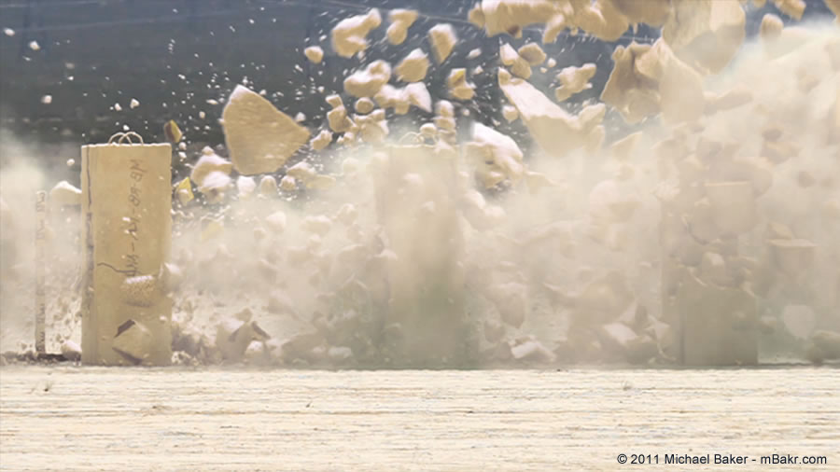
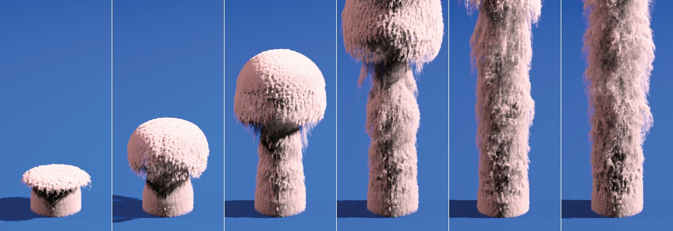
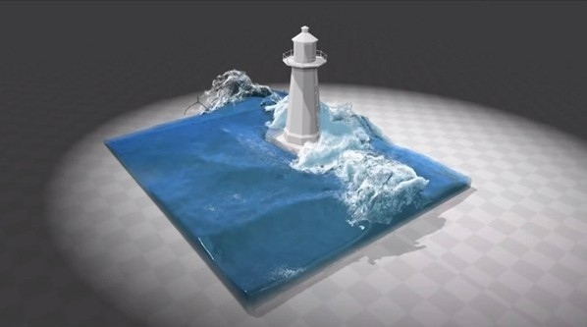
Applications of Physically-based Rendering
Applications of Physically-based Rendering
Visualization for scientific data and physical simulation

Slide 7
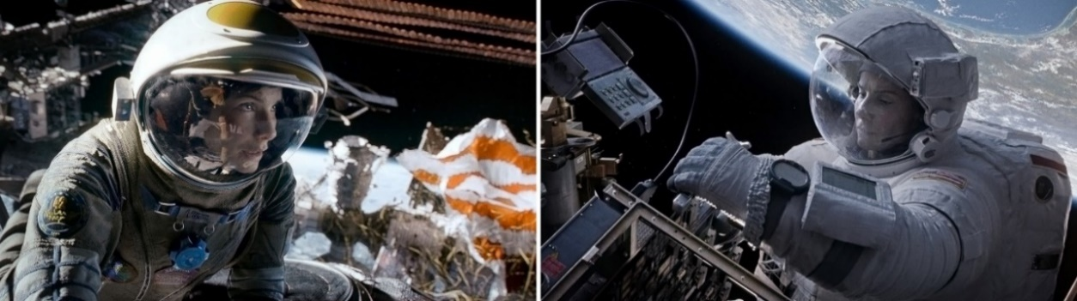
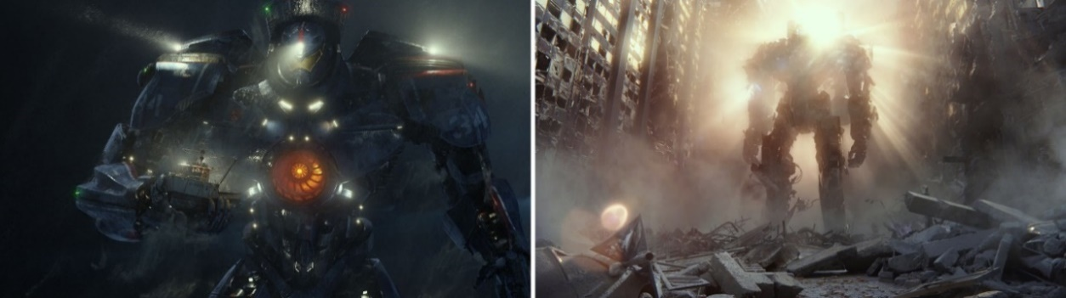
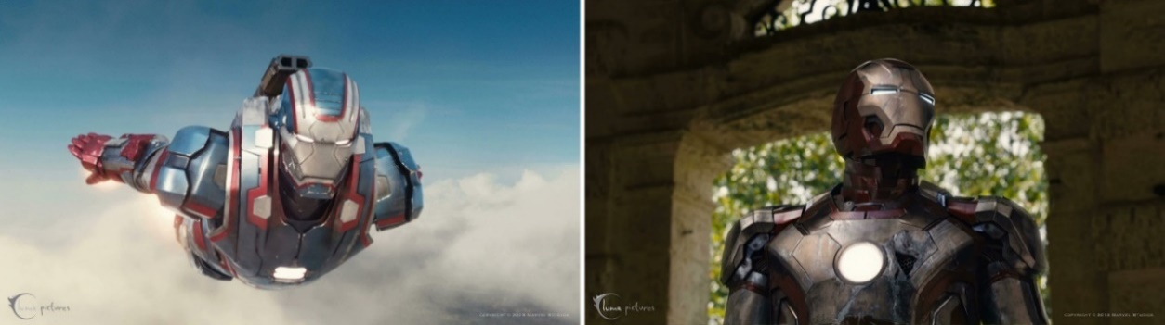
Applications of Physically-based Rendering
Feature movies production
Gravity
2013
Pacific Rim
2013
Iron Man 3
2013
Copyright © Solid Angle Inc. All rights reserved

Slide 8
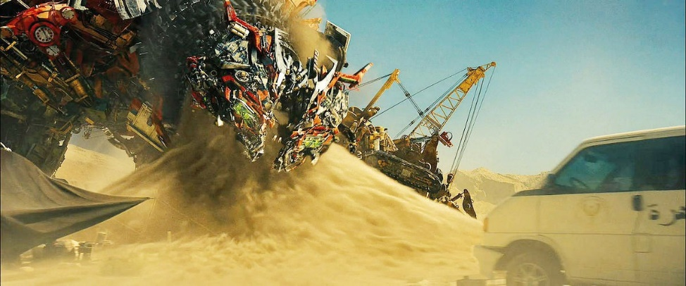
Motivations
Rendering is still a time-consuming task even though the rendering algorithms and graphics hardware have been improved a lot in these years
“rendering drives the largest computational budget of getting the pixels to the screen”
by Dana Batali, vice president of RenderMan
72 hours / frame
The devastator from Transformers: Revenge of the Fallen, 2009
Notes:
Simulation (physical simulations like cloth, fluid, etc.) were only about 5% of most film’s computational budget

Slide 9
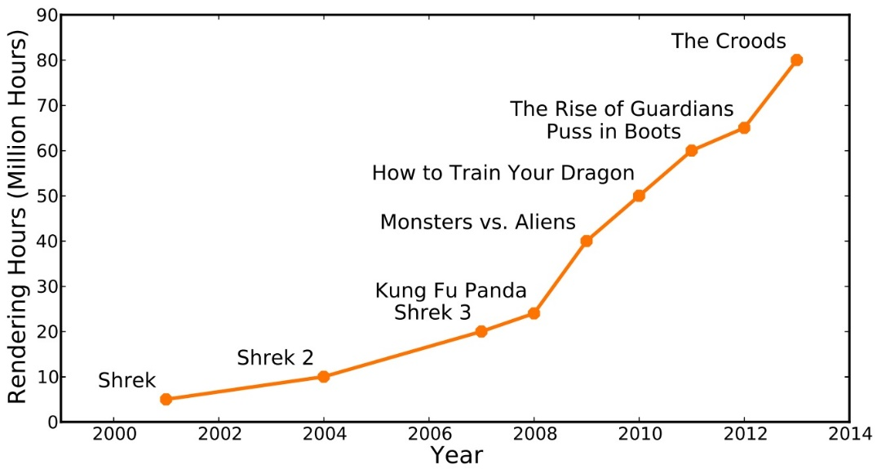
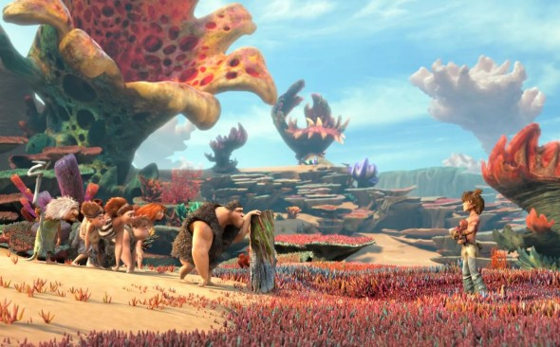
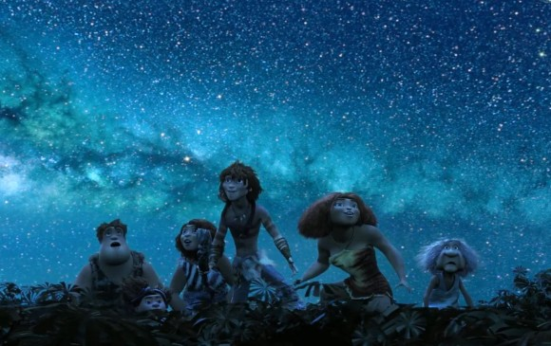
Motivations
Goal:
develop
more
efficient and scalable
algorithms
Notes:
When the movie industry moved from producing 2D to 3D high-definition movies over the past decade, the data required to produce the films increased tremendously. For DreamWorks, the amount of data needed to create a stereoscopic film leaped by 30%
Between 300 and 400 animators worked on "The Croods" over the past three years. The images, from raw sketches to stereoscopic high-definition shots, required about 250TB of data storage capacity to make, according to Kate Swanborg, head of enterprise marketing at DreamWorks.

Slide 10
Outline
Introduction
Background
Proposed Methods
VisibilityCluster: Average Directional Visibility for Many-Light Rendering
Dual-Matrix Sampling for Scalable Translucent Material Rendering
SURE-based Optimization for Adaptive Sampling and Reconstruction
Conclusion

Slide 11
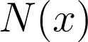
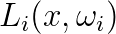
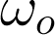
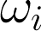
The Rendering Equation
The most important equation which describes the interaction between lights and surfaces [Kajiya, 1986]
incident radiance
bidirectional reflectance distribution function
(BRDF)
Notes:
這個equation描述的是場景中的一個點x, 沿著wo方向傳遞的能量大小
造成能量往這個方向傳遞的原因有兩種, 如果x是light source的話, 他會往wo發出Le大小的能量
同時, 也有可能是場景中的其他光線, 打到x點之後往wo反射
對於一條從wi來的入射光, 其造成的貢獻是他的能量Li乘上其往wo反射的比例(BRDF), 再乘上一個cosine theta
因為要考慮所有的入射角度, 我們會以x點的法向量N(x)定義出一個上半球面, 將從入射方向wi進來而往wo離開的能量積起來

Slide 12
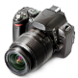

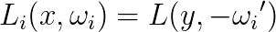

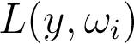
Rendering with Ray Tracing
Trace rays to simulate a variety of light transport paths
Notes:
當我們要透過rendering equation來得到一張影像時
我們會從場景中的camera透過影像上的pixel射出一條ray, 他會與場景有個交點x
這個點就是camera透過pixel應該要看到的物體. 我們將x這個點稱為shading point
我們的目的就是在這點求解rendering equation以得到這條ray, 也就是這個pixel的顏色
因此我們沿著入射方向將所有沿著wi進來而往wo反射的能量積起來
我們除了要考慮光源直接打到x這點的case之外,
還得考慮光先打到場景其他物體, 再打到x這點的情形, 也就是所謂的indirect illumination
在這個case下, indirect illumination的大小, 我們必須在這個點也計算一次rendering equation
因此, 我們會需要一個recursive的evaluation

Slide 13
Rendering with Ray Tracing
To compute the color of a pixel (i , j), we need to integrate:
Global illumination and anti-aliasing
+ Depth of field (integrate over the camera lens)
+ Motion blur (integrate over the time shutter is open)
Notes:
1: I(i,j) = \int_{i-1/2}^{i+1/2} \int_{j-1/2}^{j+1/2} \int_{\Omega_{1}} \cdots \int_{\Omega_{n}} f(x,y,\omega_{i_{1}},\cdots,\omega_{i_{n}}) d\omega_{i_{n}} \cdots d\omega_{i_{i}}dydx
2: I(i,j) = \int_{i-1/2}^{i+1/2} \int_{j-1/2}^{j+1/2} \int_{-1}^1 \int_{-1}^{1} \int_{\Omega_{1}} \cdots \int_{\Omega_{n}} f(x,y,u,v,\omega_{i_{1}},\cdots,\omega_{i_{n}}) dvdu d\omega_{i_{n}} \cdots d\omega_{i_{i}}dydx
3: I(i,j) = \int_{i-1/2}^{i+1/2} \int_{j-1/2}^{j+1/2} \int_{-1}^1 \int_{-1}^{1} \int_{t_{0}}^{t_{1}} \int_{\Omega_{1}} \cdots \int_{\Omega_{n}} f(x,y,u,v,t,\omega_{i_{1}},\cdots,\omega_{i_{n}}) dtdvdu d\omega_{i_{n}} \cdots d\omega_{i_{i}}dydx

Slide 14
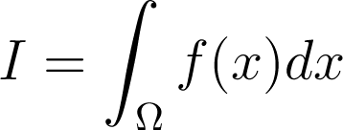
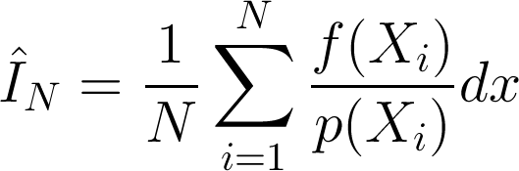
Monte Carlo Integration
The rendering equation is recursive, resulting a high-dimensional integral
It has no analytical solution
Monte Carlo integration is the only feasible approach for estimating the integral
Estimate function values with stochastic point samples (drawn according to a pdf) in the integral domain
Combine sample results with an estimator
Notes:
Remember to say: drawn samples from the pdf p(xi)

Slide 15
Monte Carlo Integration
Pros:
Robust for high-dimensional integral
General for simulating a variety of light transport paths
Cons:
Slow convergence
Producing undesired artifacts when samples are not enough

Slide 16
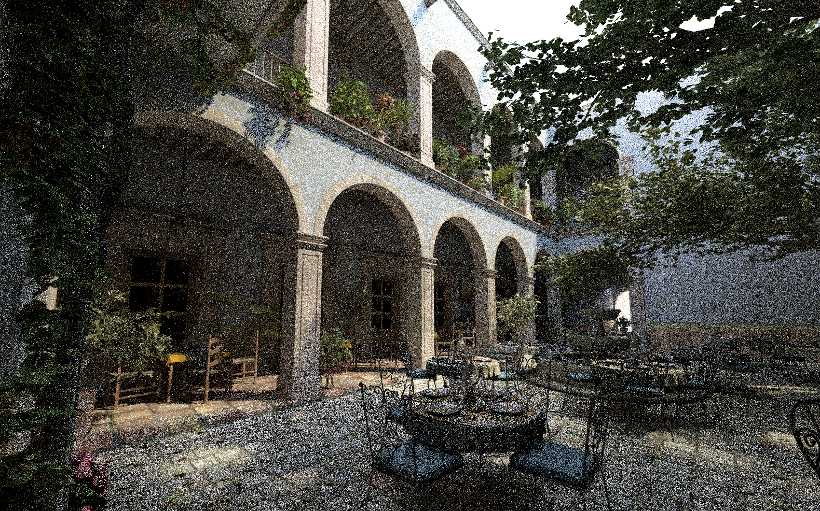
Monte Carlo Integration
Sanmiguel scene, 1209 sec. with Monte Carlo path tracing on a machine with Intel dual-quad core 2.5GHz CPU and 32GB of RAM

Slide 17
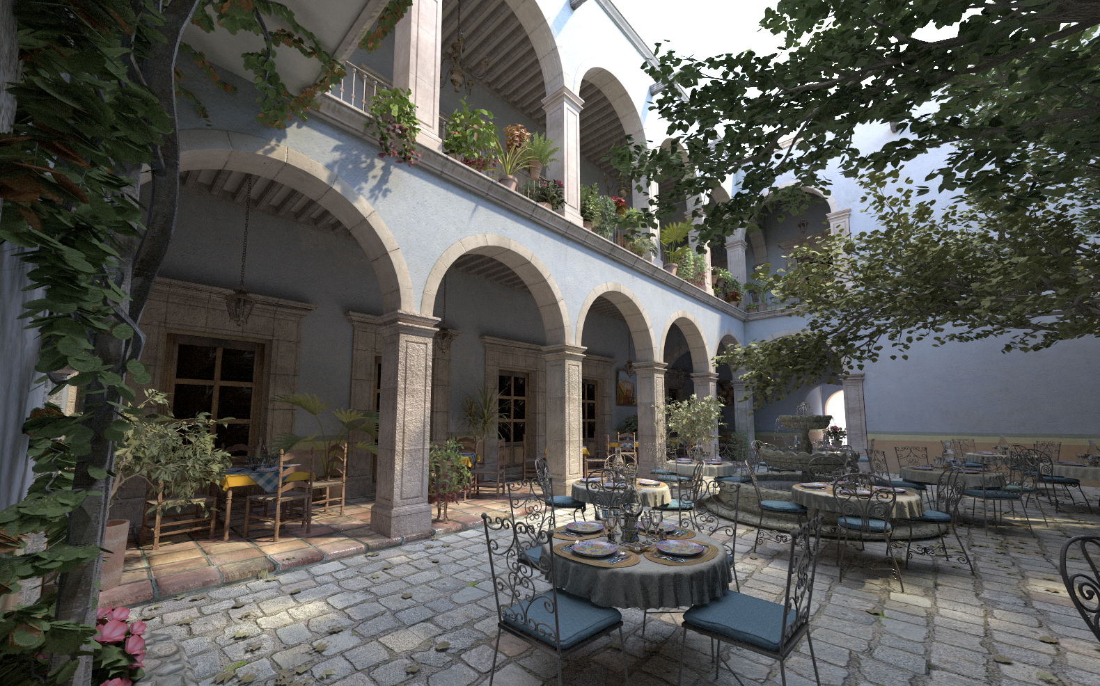
Monte Carlo Integration
Sanmiguel scene, 39 hours with Monte Carlo path tracing on a machine with Intel dual-quad core 2.5GHz CPU and 32GB of RAM

Slide 18
Virtual Point Light (VPL) Method
Computing multi-bounce indirect lighting requires to evaluate the rendering equation recursively
Virtual point light methods can break the recursion
It also provides a unified framework for handling all types of illumination

Slide 19
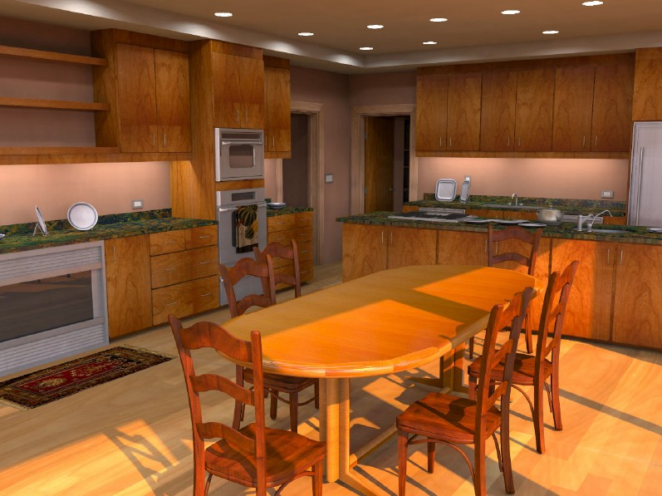
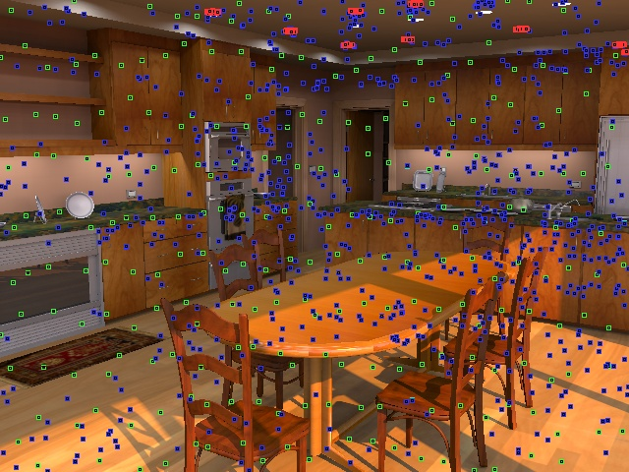
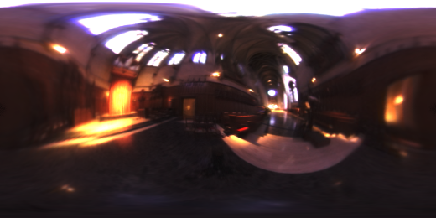
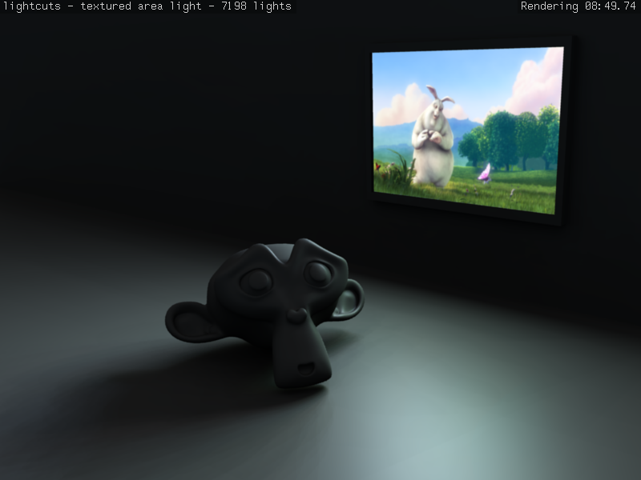
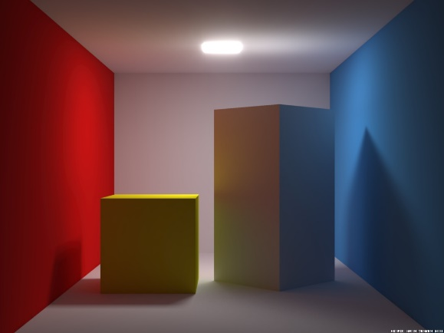
Virtual Point Light (VPL) Method
Pass I: convert the illumination in the scene into a large number of virtual point lights (VPLs)
Environment lights
Area lights
Indirect illumination

Slide 20
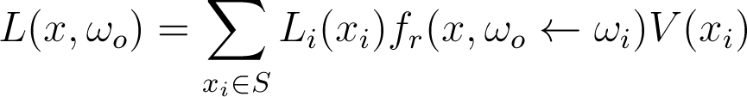
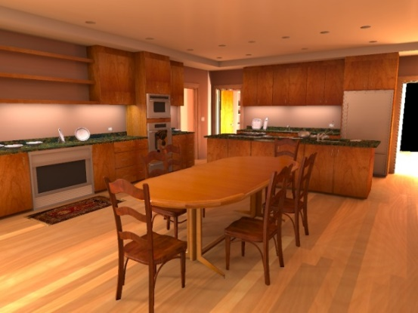

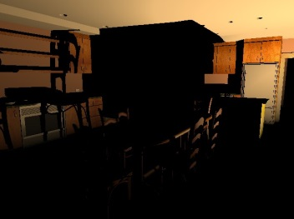
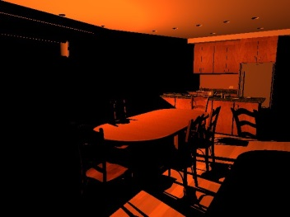
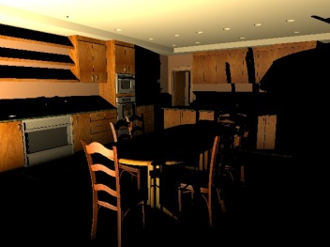
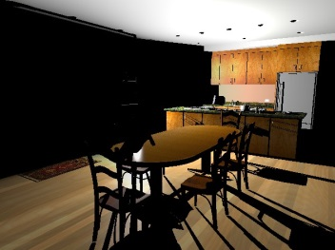
Virtual Point Light (VPL) Method
Pass II: for each pixel, gather contributions of all VPLs
100000 VPLs

Slide 21
Outline
Introduction
Background
Proposed Methods
VisibilityCluster: Average Directional Visibility for Many-Light Rendering
Dual-Matrix Sampling for Scalable Translucent Material Rendering
SURE-based Optimization for Adaptive Sampling and Reconstruction
Conclusion

Slide 22
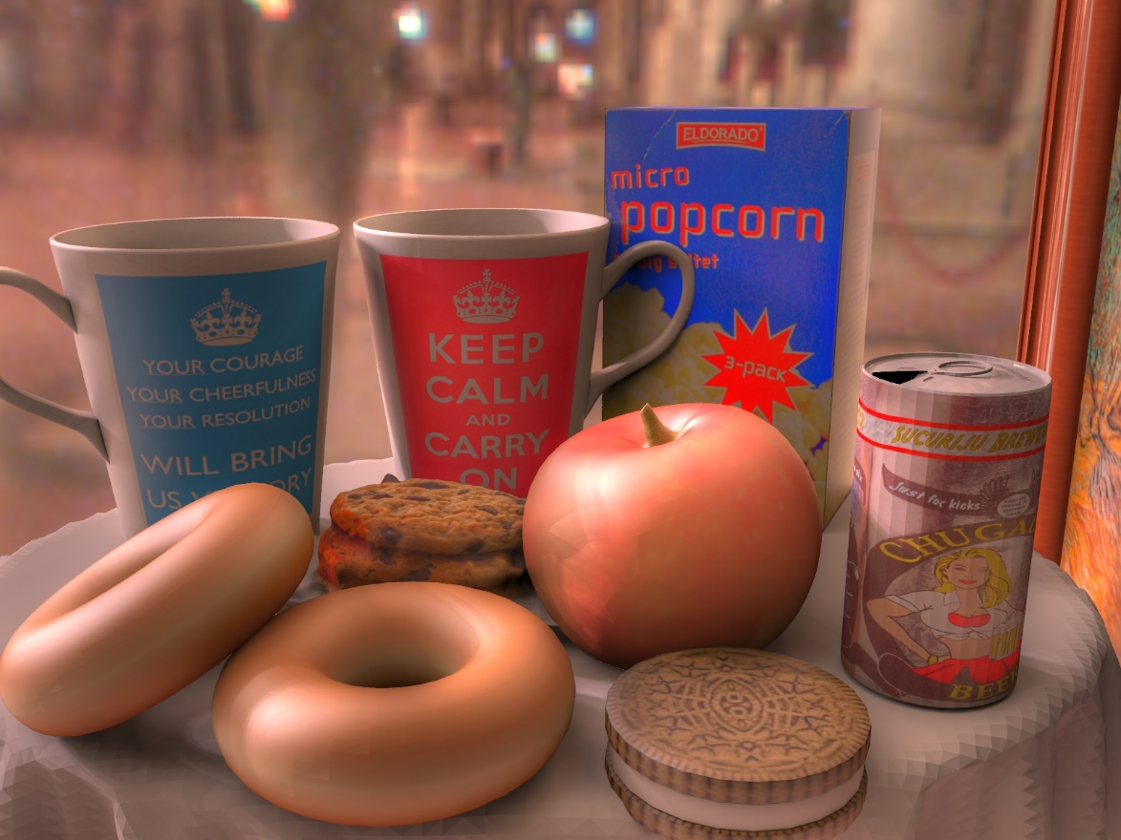
Motivation
When shading a surface sample, concentrate computational resource on important directions (lights)

Slide 23
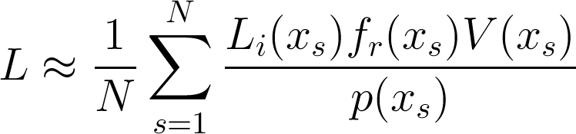
Problem Formulation
We focus on rendering with VPLs
Representing complex illumination requires a large number of VPLs
Accumulating contributions of all VPLs is impractical
Employ a Monte Carlo estimator:
S: the set of VPLs

Slide 24
Problem Formulation
How to determine the sampling distribution for reducing the number of samples N ?
Random sampling ?
Uniform sampling ?
Importance sampling

Slide 25
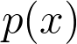
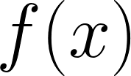
Importance Sampling
The Monte Carlo estimator
converges more quickly if
the sampling distribution is similar to
If we use a normalized version of for , we can have zero variance

Slide 26
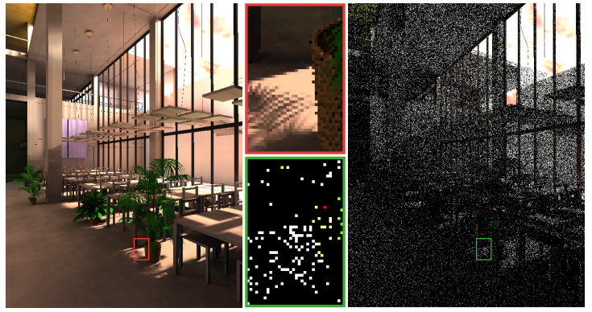
Importance Sampling
Rendering with only one sample (VPL) per pixel.
(left: perfect pdf; right: poor pdf)

Slide 27
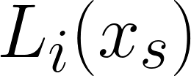
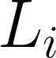




Problem Formulation
Apply importance sampling to reduce the number of samples
In the case of VPL rendering, we would like
We do not have the perfect sample distribution and can only approximate it
Need efficient approximations of
?

Slide 28


Related Work
Bidirectional Importance Sampling for Unstructured Importance Sampling (Eurographics 2009)
- R. Wang and O. Akerlund
illumination only
BRDF only
BIS (this paper)

Slide 29

Related Work
Bidirectional Importance Sampling for Unstructured Direct Illumination (Eurographics 2009)
- R. Wang and O. Akerlund
avg. BRDF
# lights
avg. lum
0/4
3/4
light clusters
1/4
BRDF importance sampling

Slide 30

Related Work
Importance Caching for Complex Illumination (Eurographics 2012)
- I. Georgiev, J. Krivanek, S. Popov, and P. Slusallek
RIS: Resampled Importance Sampling (Eurographics 2005)
PT: Path Tracing

Slide 31
Related Work
Importance Caching for Complex Illumination (Eurographics 2012)
- I. Georgiev, J. Krivanek, S. Popov, and P. Slusallek
Combine perfect sampling functions from neighboring caches

Slide 32








Related Work
Limitations of previous approaches
Lunch
Construction
BIS: Bidirectional Importance Sampling (Eurographics 2009)
IC: Importance Caching (Eurographics 2012)

Slide 33
Method - VisibilityCluster
Observation:
similar shading points usually have similar visibility relationship to similar lights
light cluster
shading cluster

Slide 34

Method - VisibilityCluster
Visualization: visibility terms in light transport matrix
Without reordering
lights (VPLs)
(i, j)
shading points
visibility between light[i] and shading point[j]

Slide 35

Method - VisibilityCluster
Visualization: visibility terms in light transport matrix
Reorder the matrix
light clusters
light clusters
shading clusters
4856 sec.
VisibilityCluster

Slide 36

Method - VisibilityCluster
Visualization: visibility terms in light transport matrix
Average visibility of VisibilityCluster
light clusters
shading clusters
4856 sec.

Slide 37

Method - VisibilityCluster
Visualization: visibility terms in light transport matrix
Our efficient approximation
light clusters
shading clusters
14 sec.

Slide 38
Method - VisibilityCluster
Advantages of using average visibility:
It can be accurately estimated with few shadow tests
It is compact and scalable
It is directly related to visibility variance and can be used for further refinement

Slide 39
Method
Construction of VisibilityClusters
Initial clustering (based on geometric properties)
Light clustering
Shading point clustering
Average visibility estimation
Local refinement
unknown
matrix
initial
clustering
average visibility
estimation
local
refinement

Slide 40


Method - Average Visibility Estimation
In this case:
Usually 10 – 12 rays are enough in our implementation.

Slide 41



Method - Local Refinement
Measure the quality of VisibilityClusters with their average visibility
Refine VisibilityCluster when

Slide 42






Method - Local Refinement
Equal-time comparison between without (w/o) and with (w/) local refinement
w/o refine
w/o refine
Killeroo
Sponza
w/ refine
w/ refine

Slide 43

Method - Integrated to BIS
For each shading point, we select a light from the set of VPLs by
Compute bidirectional importance of all lights
Multiply bidirectional importance with the average visibility stored in VisibilityClusters
Sample a light cluster k based on the triple-product importance
Uniformly sample a light from the selected light cluster
avg. BRDF
# lights
avg. lum
avg.
visibility

Slide 44


Results
We conduct equal-time comparisons with the following methods:
Bidirectional Importance Sampling for Unstructured Direct Illumination (BIS)
R. Wang and O. Akerlund (Eurographics 2009)
Importance Caching for Complex Illumination (IC)
I. Georgiev, J. Krivanek, S. Popov, and P. Slusallek
(Eurographics 2012)

Slide 45









Results - Lunch
180.8K triangles, 32.8K VPLs
environment lighting, glossy materials
Our
BIS
200.3 sec.
0.064530
IC
200.5 sec.
0.014324
Our
199.8 sec.
0.005783
Reference
Time
MSE

Slide 46









Results - Room
462.9K triangles, 40.6K VPLs
global illumination, glossy materials
Our
BIS
300.6 sec.
0.020244
IC
299.9 sec.
0.012640
Our
301.2 sec.
0.006246
Reference
Time
MSE

Slide 47









Results - Construction
272.6K triangles, 65.5K VPLs
environment lighting, fine geometry
Our
BIS
499.5 sec.
0.111308
IC
502.1 sec.
0.087237
Our
500.5 sec.
0.020968
Reference
Time
MSE

Slide 48
Summary of VisibilityCluster
VisibilityCluster is a method for compact representation and efficient approximation of visibility functions
It can be directly combined into bidirectional importance sampling, achieving superior noise reduction

Slide 49
Outline
Introduction
Background
Proposed Methods
VisibilityCluster: Average Directional Visibility for Many-Light Rendering
Dual-Matrix Sampling for Scalable Translucent Material Rendering
SURE-based Optimization for Adaptive Sampling and Reconstruction
Conclusion

Slide 50



Motivation
If the scene has translucent objects, concentrate computational resource on important surface samples
BSSRDF
scene
rendering

Slide 51


Subsurface Scattering
Subsurface scattering is a process allowing lights to enter and scatter within medium
Its simulation gives rendered objects a distinct soft look

Slide 52


Subsurface Scattering
BRDF v.s. BSSRDF
Bidirectional Subsurface Scattering Reflectance Distribution Function (BSSRDF)
Bidirectional Reflectance Distribution Function
(BRDF)

Slide 53
BSSRDF
Replace BRDF with BSSRDF
For highly scattering materials, a very large number of paths should be simulated
Jensen et al. [2001] proposed a dipole diffusion model to reduce shading cost

Slide 54

Dipole Diffusion Model

Slide 55

Dipole Diffusion Model
Irradiance

Slide 56

Dipole Diffusion Model

Slide 57


Related Work (Two-pass)
A Rapid Hierarchical Rendering Technique for Translucent Materials (SIGGRAPH 2002)
- H. W. Jensen and J. Buhler
BRDF
BSSRDF

Slide 58

Related Work (Two-pass)
A Rapid Hierarchical Rendering Technique for Translucent Materials (SIGGRAPH 2002)
- H. W. Jensen and J. Buhler
Pass1
Pass2

Slide 59

Related Work (Two-pass)
A Rapid Hierarchical Rendering Technique for Translucent Materials (SIGGRAPH 2002)
- H. W. Jensen and J. Buhler
Pass1
Pass2
The diffuse BSSRDF R_{d} decreases exponentially with distance
Traverse an octree with refining metric:

Slide 60

Related Work (Single-pass)
Single-pass Scalable Subsurface Rendering with Lightcuts (Eurographics 2008)
- A. Arbree, B. Walter, and K. Bala
this paper
1258 sec.
reference
52717 sec.

Slide 61
Related Work (Single-pass)
Single-pass Scalable Subsurface Rendering with Lightcuts (Eurographics 2008)
- A. Arbree, B. Walter, and K. Bala
Compute surface irradiance on demand
Refine tree if the potential error is larger
Its error bound does not include visibility
surface tree
light tree

Slide 62

Related Work
The traditional two-pass approach can reuse surface irradiance, but is ineffective for its view-independent irradiance computation
close-up rendering
severe occlusion

Slide 63


Related Work
The single-pass approach is view-dependent, but it has visibility issue and could not reuse surface irradiance intuitively
backlit
difficult light path

Slide 64
Motivations
We would like to design a new method which combines the advantages of both two-pass and single-pass approaches
Reuse irradiance computation
Two-pass method
View-dependent irradiance computation
By estimating the importance of surfaces sample without evaluating them
Refine surface samples adaptively based on the estimated error

Slide 65
Method
Discretize the illumination, surface, and image domains
VPLs
camera samples
(shading points)
E
surface samples
R_{d}

Slide 66



Method - Dual-matrix Representation
Represent the transport of light-surface-camera as two matrices:
light samples
VPLs
surface samples
Light-to-Surface matrix
E
camera
sample
camera samples
surface
sample
R_{d}
surface samples
Surface-to-Camera matrix

Slide 67

Method - Flowchart
max. contribution of a surface cluster:
L
S
?
unknown
LS matrix
clustered
LS matrix
sampled
LS matrix
max.
irradiance
vector
S
?
C
max.
BSSRDF
vector
unknown
SC matrix
clustered
SC matrix
sampled
SC matrix
pass I
Notes:
這邊要先提一下,
我們的方法主要目的是要估計surface samples對整張影像的重要性, 不重要的surface samples可以省略計算
因為場景中的surface samples數目通常太多, 我們沒辦法一一決定他們的重要性, 同時相似的surface samples又會擁有很高的coherence
因此我們採用clustering-based的方法
也就是說, 我們一次考慮一個surface cluster的重要性

Slide 68

Method - Flowchart (cont.)
max.
irradiance
vector
max.
subsurface
scattering
vector
selective
reconstructed
LS matrix
adaptive
diffusion
approximation
(SC matrix)
irradiance
vector
max.
BSSRDF
vector
pass I
pass II

Slide 69

Method - Pass I
Avoid computing unnecessary surface samples
Maximum contribution of a surface cluster C:
If the is larger than a threshold, evaluate all the cluster members
Otherwise, only evaluate the surface representative
How to estimate for each surface cluster?
max. error

Slide 70


Method - Pass I
Estimate from the Light-to-Surface matrix
Exploit its low-rank property
light
?
surface
sampled
irradiance
max.
irradiance
vector
unknown
LS matrix
clustered
LS matrix
sampled
LS matrix
Light clustering:
LightSlice [Ou and Pellacini, 2011]
Surface sample clustering:
6D bvhtree
max.
irradiance
in each cluster

Slide 71


Method - Pass I
Estimate from the Surface-to-Camera matrix
Exploit its sparse structures
kdtree
surface
?
camera
clustered
SC matrix
lookup
unknown
SC matrix
build kdtree
for camera clusters
find kNN camera clusters
Camera clustering:
6D kdtree
max.
BSSRDF
vector

Slide 72
Method - Pass II
Adaptively refine surface samples based on the estimated error
Pass1
Pass2
Traverse an octree with refining metric:

Slide 73


Method - Pass II
Adaptively refine surface samples based on the estimated error
For each node C in the acceleration structure, we compute
Stop refining if
max. error
due to approximation

Slide 74







Method - Comparisons
Equal-time comparison (50 sec.) on the refining metrics used in Pass II
MSA: maximum solid angle [Jensen and Buhler. 2002]
OUR: our error-based refining metrics

Slide 75


Results
We conduct equal-time comparisons with the following methods:
A Hierarchical Rendering Technique for Translucent Materials (JB)
H.W. Jensen and J. Buhler (SIGGRAPH 2002)
Single-pass Scalable Subsurface Rendering with Lightcuts (Arbree)
A. Arbree, B. Walter, and K. Bala (Eurographics 2008)

Slide 76









Results - Sculpture
800.2K triangles, 18.4K VPLs, 13.0M surface samples
(environment +area) lighting, close-up rendering
Our
J.B.
30.6 sec.
0.003270
Arbree
30.2 sec.
0.003040
Our
29.4 sec.
0.000588
Reference
Time
RMSE

Slide 77









Results - Cathedral
157.7K triangles, 11.7K VPLs, 6.6M surface samples
environment lighting, backlit
Our
J.B.
30.8 sec.
0.000107
Arbree
31.0 sec.
0.000330
Our
30.5 sec.
0.000082
Reference
Time
RMSE

Slide 78









Results - Room
503.7K triangles, 165.9K VPLs, 13.8M surface samples
(environment + area) lighting, difficult light paths
Our
J.B.
303.4 sec.
0.000347
Arbree
306.7 sec.
0.001420
Our
299.8 sec.
0.000114
Reference
Time
RMSE

Slide 79









Results - Exhibition
7.4M triangles, 186.4K VPLs, 20.5M surface samples
(environment + area) lighting, complex occlusion
Our
J.B.
302.1 sec.
0.011949
Arbree
300.9 sec.
0.016933
Our
301.4 sec.
0.007185
Reference
Time
RMSE

Slide 80
Summary of Dual-matrix Sampling
We propose a dual-matrix representation for solving the problem of translucent material rendering under complex illumination
We also propose a sampling and reconstruction algorithm based on the dual-matrix representation
reduce unnecessary computation of surface samples
improve adaptive diffusion approximation

Slide 81
Outline
Introduction
Background
Proposed Methods
VisibilityCluster: Average Directional Visibility for Many-Light Rendering
Dual-Matrix Sampling for Scalable Translucent Material Rendering
SURE-based Optimization for Adaptive Sampling and Reconstruction
Conclusion

Slide 82


Motivation
concentrate computational resource on difficult pixels and apply appropriate filters to reduce noise
sampling density

Slide 83






Rendering Distributed Effects
To render photo-realistic images, we usually need to simulate several distributed effects:
Depth of field
Glossy reflection
Global illumination
Motion blur
Soft shadow
Global illumination
Motion blur
Soft shadow

Slide 84
Rendering Distributed Effects
Recall: each distributed effect adds one or two dimensions in Monte Carlo integration
Global illumination: integration over the hemisphere
Antialiasing: integration over the pixel
Depth of field: integration over the aperture of camera lens
Motion blur: integration over the time the camera shutter is open

Slide 85


Rendering Distributed Effects
When solving a high-dimensional integral, rendering takes a long time to converge
68 samples per pixel
(890 sec.)
8192 samples per pixel
(1 day 4 hours)

Slide 86
Adaptive Rendering
Adaptive sampling
Given a fixed budget of samples, adaptive sampling decides the optimal sample distribution and concentrates more samples on difficult regions
Reconstruction
Reconstruction algorithms properly construct smooth results from the discrete samples at hand

Slide 87
Challenges
Adaptive sampling
Require a robust criterion for measuring pixel error for determining which pixels are worth more effort
Reconstruction
Require to select the optimal reconstruction for each pixel (optimal filter is usually spatially-varying and anisotropic)

Slide 88

Related Work - GEM
Adaptive Sampling and Reconstruction using Greedy Error Minimization [Rousselle et al., 2011]
initialization
4 samples / pixel
iter2
iter3
iter4
results
32 samples / pixel
row1: filter selection
row2: sample density map
row3: reconstruction

Slide 89







Related Work - GEM
Flowchart of GEM:
Gaussian
Filterbank
Color
Renderer
No
Mean
Var.
Finish?
Yes
Error Estimator
Sample
Density
Filter
Scale
Isotropic Filter Only!
Notes:
GEM:
fine與coarse filter之間的bias關係透過quadratic approximation可寫成一個關係
此關係可幫助判斷error變大還是變小

Slide 90



Related Work - GEM
Problems with GEM [Rousselle et al., 2011]
Isotropic filters cannot adopt to scene features well
Examples:

Slide 91


Goal: Using More Effective Filters
Improve GEM by using more effective filters
Cross-bilateral filters, non-local-mean filters, … etc
In our implementation, we focus on cross-bilateral filters
Cross bilateral filter [Eisemann and Durand, 2004]
Require an
error estimator for cross bilateral filter

Slide 92
Method - Notation

Slide 93


Method - Notation
- Mean
Filtered:
- Variance
- Converged
(ground truth)

Slide 94

Method - Estimating Filter Error
Want to estimate:
Don’t know

Slide 95
Method - Estimating Filter Error
Want to estimate:
Stein’s Unbiased Risk Estimator
[Stein, 1981]
Notes:
SURE沒有限制MC estimator必須是unbiased, 但是他估計的error就是對那個bias estimator的error
舉例來說, 使用SURE+cross bilateral filter估計VPL-rendering (+clamping)的error
SURE估計的到cross bilateral filter的bias, 但是估不到VPL clamping的error
SURE的限制在於他期望noise和variance的分佈是Gaussian, 所以理論上拿SURE來估計non-Gaussian的noise (ex: caustics) 效果會不佳

Slide 96

Method - Estimating Filter Error
Want to estimate:
analytically derived for cross bilateral filters

Slide 97



Method - Flowchart
Cross-Bilateral Filterbank
Color + Features
Renderer
No
Mean
Var.
Features
Finish?
Yes
SURE MSE Estimator
Sample
Density
Filter
Scale

Slide 98






Method - Comparison with GEM
Kernel visualization
Reference
4096 spp (~3000 sec.)
GEM
51.82 spp (61.8 sec.)
Our
39.79 spp (60.9 sec.)

Slide 99



Results
We conduct equal-time comparisons with the following methods:
Traditional Monte Carlo Path Tracing (MC)
Default implementation in PBRT2
Uniform sample distribution and per-pixel box filter
Neither adaptive sampling nor filtering
Adaptive Sampling and Reconstruction using Greedy Error Minimization (GEM)
F. Rousselle, C. Knaus, and M. Zwicker (SIGGRAPH Asia 2011)
On Filtering the Noise from the Random Parameters in Monte Carlo Rendering (RPF)
P. Sen and S. Darabi (ACMTOG 2012)

Slide 100











Results - Sibenik
global illumination, depth of field
Our
MC
140 sec.
0.029946
GEM
135 sec.
0.002070
RPF
363 sec.
0.006103
Our
140 sec.
0.001489
Reference
Time
relative MSE

Slide 101











Results - Sponza
global illumination, motion blur
Our
MC
890.5 sec.
0.133096
GEM
906.2 sec.
0.017605
RPF
1676.1 sec.
0.031972
Our
896.0 sec.
0.012097
Reference
Time
relative MSE

Slide 102











Results (limitation) - Teapot
environment lighting, glossy reflection
Our
MC
42.0 sec.
0.199485
GEM
44.3 sec.
0.171002
RPF
374.4 sec.
0.233701
Our
40.4
0.143123
Reference
Time
relative MSE

Slide 103
Summary of SURE-based Optimization
We apply the SURE into rendering community, specifically for adaptive rendering
Using SURE allows our method to estimate error of more effective filters, rather than the isotropic ones used in previous work
Experiments show that our method can better adapt to detailed geometry and complex textures

Slide 104
Outline
Introduction
Background
Proposed Methods
VisibilityCluster: Average Directional Visibility for Many-Light Rendering
Dual-Matrix Sampling for Scalable Translucent Material Rendering
SURE-based Optimization for Adaptive Sampling and Reconstruction
Conclusion

Slide 105
Conclusion
We proposed three rendering techniques based on sampling and reconstruction to improve the efficiency of Monte Carlo rendering:
VisibilityCluster for efficient visibility approximation and global illumination
Dual-matrix representation and sampling for scalable translucent material rendering
SURE-based adaptive rendering for a wide range of distributed effects

Slide 106
Thank you !

Slide 107
Backup Slides

Slide 108

Overview

Slide 109
Virtual Point Light (VPL) Method
Advantages of using virtual point lights:
Light paths are reused
Noise is reduced since paths are highly correlated (but may result in bending artifacts)
Visibility can be determined with shadow maps
All types of illumination can be handled in a united manner

Slide 110

Virtual Point Light (VPL) Method
Path tracing
Virtual point lights

Slide 111




Overview

Slide 112



Method - Initial Clustering
Light clustering
IlluminationCut [Cheslack-Postava et al., 2008]
Build a light tree of all VPLs based on geometric properties
Find a cut of the light tree based on luminance variance and spatial extent

Slide 113


Method - Initial Clustering
Shading point clustering
6D kdtree [Walter et al., 2006, Ou and Pellacini 2011]
Build a 6D kdtree based on position and normal
Find a cut of the tree based on spatial extent
2400
shading clusters

Slide 114

Method - Refine Strategy
During local refinement, we only split the light clusters because splitting shading cluster would result in additional VisibilityCluster

Slide 115

Results
The experiment to determine the number of shadow rays for the average visibility estimation in the Lunch scene

Slide 116









Results - Town
818.0K triangles, 32.8K VPLs
environment lighting, directional occlusion
Our
BIS
149.8 sec.
0.028199
IC
151.7 sec.
0.021414
Our
150.2 sec.
0.012905
Reference
Time
MSE

Slide 117









Results - Killeroo
744.1K triangles, 32.8K VPLs
environment lighting, glossy materials
Our
BIS
306.1 sec.
0.018630
IC
308.8 sec.
0.010495
Our
301.3 sec.
0.004001
Reference
Time
MSE

Slide 118








Results - Sponza
279.2K triangles, 78.0K VPLs
global illumination, difficult light paths
Our
BIS
602.6 sec.
0.143324
IC
603.0 sec.
0.029546
Our
600.9 sec.
0.031098
Reference
Time
MSE

Slide 119









Results - Hairball
2.9M triangles, 32.8K VPLs
environment lighting, complex and detailed geometry
Our
BIS
802.3 sec.
0.411024
IC
804.1 sec.
0.410042
Our
801.5 sec.
0.081793
Reference
Time
MSE

Slide 120















Results - Error Visualization
Lunch
Killeroo
Sponza
Room
Construction
BIS
IC
Our
0.00
> 1.00

Slide 121


Results - Directional Occlusion
Local shading assumes all lights are visible, resulting in unrealistic images
Local shading, 35.4 sec.
Reference, 10047.0 sec.

Slide 122




Results - Directional Occlusion
VisibilityCluster can enhance local shading at a little cost
Local shading
35.4 sec.
VisibilityCluster
59.5 sec.
Reference
10047.0 sec.

Slide 123




Results - Directional Occlusion
Local shading, 35.4 sec.
Reference, 10047.0 sec.
VisibilityCluster (direct), 47.8 sec.
VisibilityCluster (blend), 59.5 sec.

Slide 124










Dipole Diffusion Model
The diffuse BSSRDF is defined as
and are defined by material

Slide 125









Results - ChessGame
1.5M triangles, 52.7K VPLs, 11.2M surface samples
(environment + area) lighting
Our
J.B.
110.6 sec.
0.003472
Arbree
111.5 sec.
0.005018
Our
111.2 sec.
0.001196
Reference
Time
RMSE

Slide 126




Results - Equal-Quality Comparisons
Sculpture
Cathedral
ChessGame
Exhibition

Slide 127











Results - Town
(environment + area) lighting, motion blur
Our
MC
59.9 sec.
0.029797
GEM
61.8 sec.
0.018352
RPF
272.4 sec.
0.057937
Our
60.9 sec.
0.018023
Reference
Time
relative MSE

Slide 128

Related Work - RPF
On Filtering the Noise from the Random Parameters in Monte Carlo Rendering [Sen and Darabi, 2012]
input Monte Carlo data
(8 samples / pixel)
reference rendering
(8K samples / pixel)

Slide 129
Related Work - RPF
On Filtering the Noise from the Random Parameters in Monte Carlo Rendering [Sen and Darabi, 2012]
Noise occurs in regions where the sample values are a direct function of the random parameters used in the Monte Carlo system
Reduce the importance of sample values which are affected by Monte Carlo noise during filtering
Use mutual information to estimate the dependency between color (feature) and random number

Slide 130





Related Work - RPF
On Filtering the Noise from the Random Parameters in Monte Carlo Rendering [Sen and Darabi, 2012]
Input MC
(8 spp)
Dependency of color on random parameters
Dependency of color on screen position
Fractional dependency of color on random parameters
RPF
result

Slide 131







Method - Filter Selection
Select the optimal filter for each pixel
Compute dF(c)/dc for each scale
Estimate error using SURE
Global
0.011718
Our
0.002148
Reference

Slide 132




Method - Adaptive Sampling
Measure pixel error and distribute more samples to pixels with larger error
Define the sampling function as
Pixel i will receive
if the sample budget is m
Notes:
In addition, to guide more samples to darker areas, we scale our sampling function with the squared luminance
of the filtered color. This strategy was also adopted by a previous approach [Overbeck et al. 2009] because human eyes are more sensitive to error in dark regions.

Slide 133




Result – Using Gaussian Filters
Comparisons with GEM [Rousselle et al., 2011] on the Toasters scene
GEM
MSE: 0.000287
Our
MSE: 0.000356

Slide 134









Result – Using Cross-NLM Filters
Global filtering
MSE: 0.085032
SURE
MSE: 0.012010
Reference
Global
SURE
Reference
Global
SURE
Reference
Notes:
41 spp

Slide 135
















Results - Error Visualization
Sibenik
Sponza
Town
Teapot
MC
GEM
RPF
Our
0.00
> 0.11

Slide 136
Future Work
Extend VisibilityCluster and SURE-based adaptive rendering for animation
Exploit and maintain temporal coherence
Extend Dual-matrix sampling for heterogeneous translucent materials

